Slide 1
Applying Nexus Thinking in Practice

Slide 2
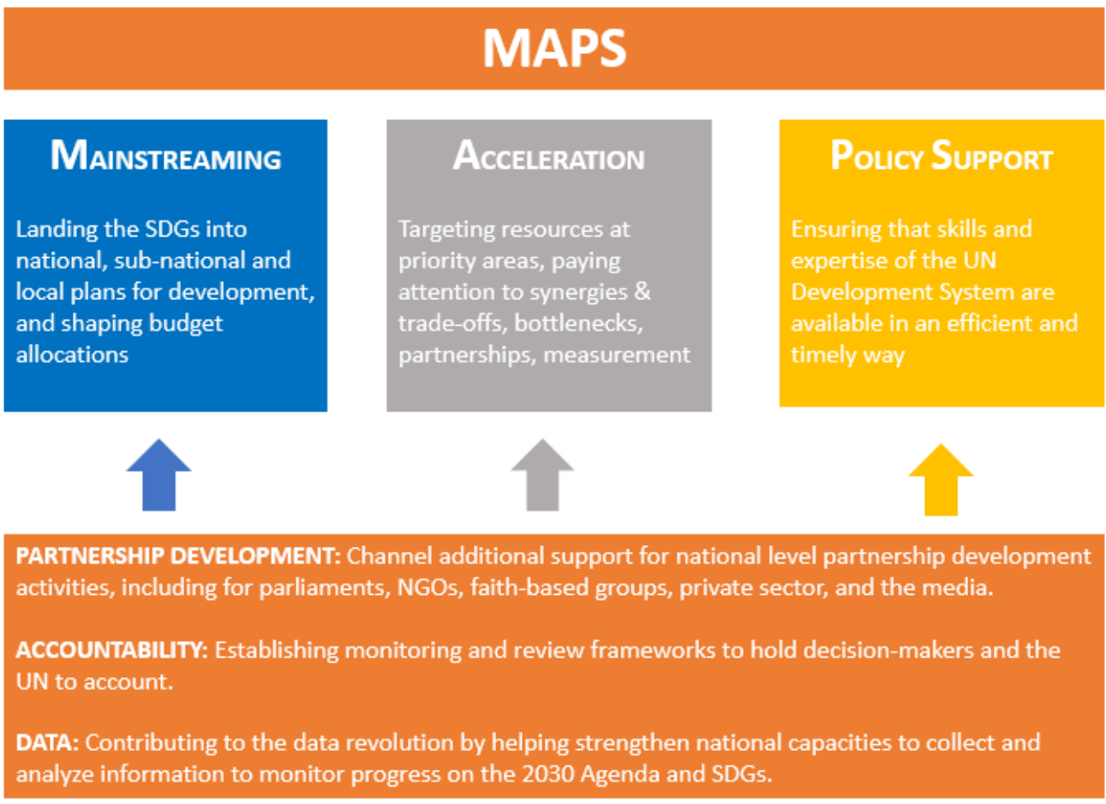
What do you want to do?
Identify potential synergy/conflict
Create a shared strategy or vision
Develop an integrated plan

Slide 3
Identify potential synergy/conflict
Futures Wheel
SWOC analysis*
Actor-network maps
* The same as a SWOT analysis, but I like “challenges” better than “threats”

Slide 4
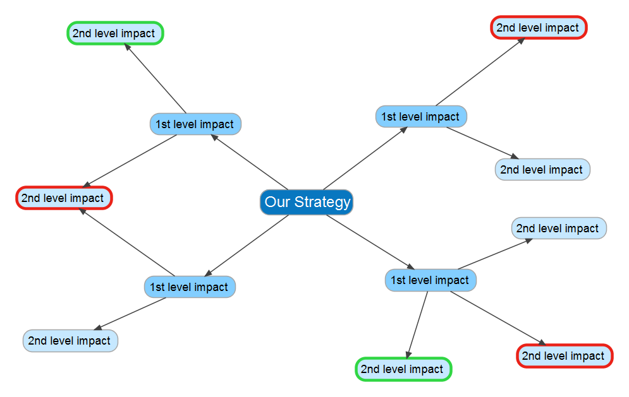
Identify potential synergy/conflict
Futures Wheel
SWOC analysis
Actor-network maps

Slide 5
Identify potential synergy/conflict
Strengths | Weaknesses
Opportunities | Challenges
Futures Wheel
SWOC analysis
Actor-network maps
What can we offer?
Where could we use help?
What initiatives can we contribute to?
What initiatives could constrain us?

Slide 6
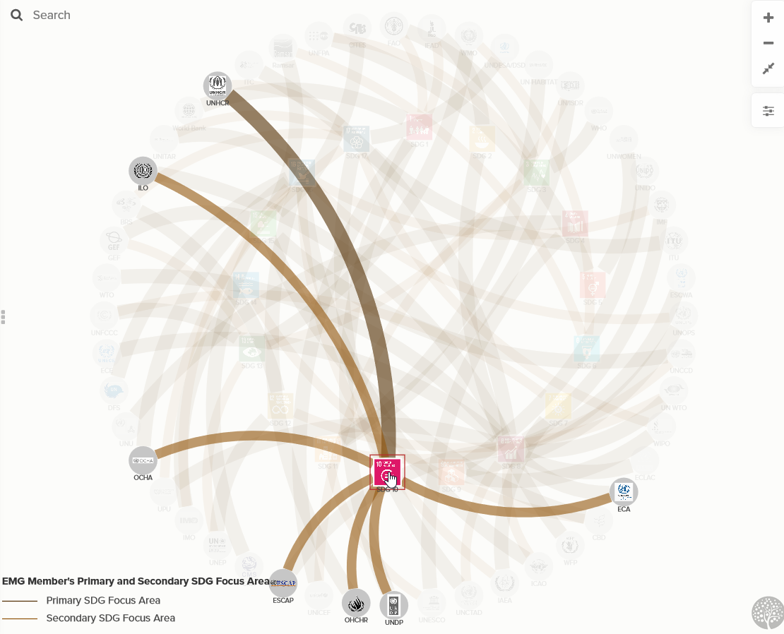
Identify potential synergy/conflict
Futures Wheel
SWOC analysis
Actor-network maps

Slide 7
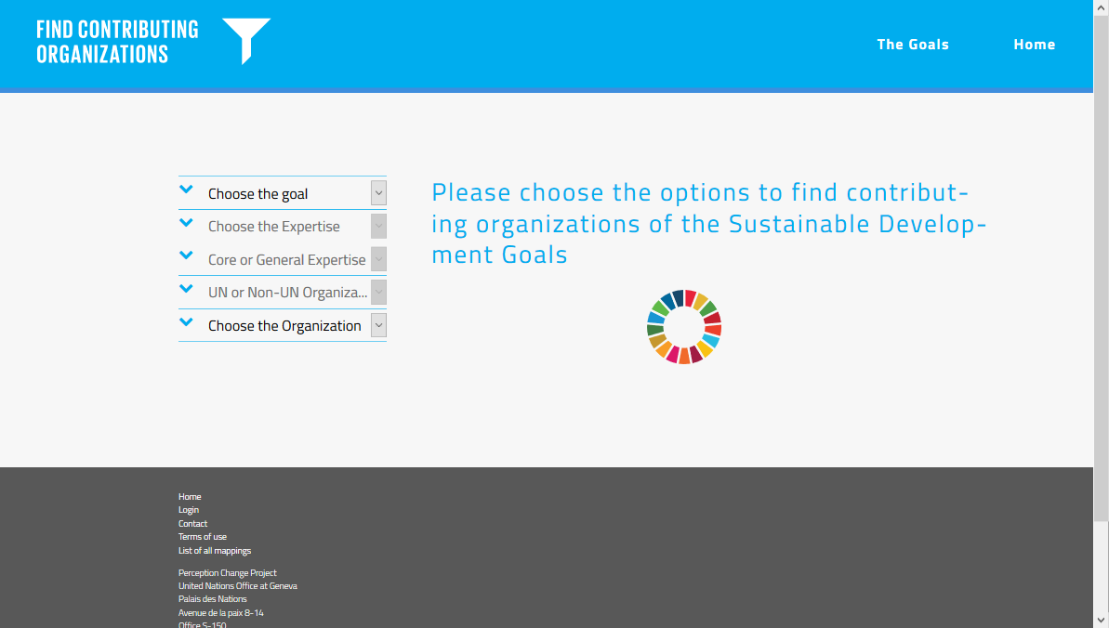
Identify potential synergy/conflict
Futures Wheel
SWOC analysis
Actor-network maps
http://www.geneve-int.ch/sdgmapping/index.html

Slide 8
Create a shared strategy or vision
Scenarios: Intuitive logics
Scenarios: Backcasting
Participatory mapping

Slide 9
Create a shared strategy or vision
Driving Forces
What forces, out of our direct control, are shaping the system?
Scenarios: Intuitive logics
Scenarios: Backcasting
Participatory mapping
Critical Uncertainties
Which driving forces are both highly uncertain and have a high impact?
Scenario Logic
What combinations of critical uncertainties are useful to consider?
Robust Plans
What policies, plans, or initiatives do best under multiple possible futures?

Slide 10
Create a shared strategy or vision
Shared Visions
What do we want the future to look like?
Scenarios: Intuitive logics
Scenarios: Backcasting
Participatory mapping
Paths to the Futures
What steps must we take to get there?
Shared Plan
What responsibility do we each have to embark on that path?

Slide 11
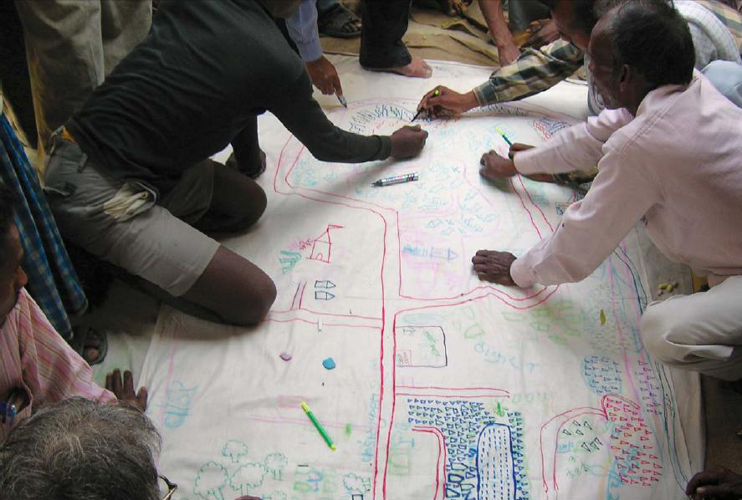
Create a shared strategy or vision
Scenarios: Intuitive logics
Scenarios: Backcasting
Participatory mapping
http://www.sswm.info/content/participatory-mapping-decision-making

Slide 12
Develop an integrated plan
Multi-criteria analysis
Cross-impact analysis
Integrated modeling

Slide 13
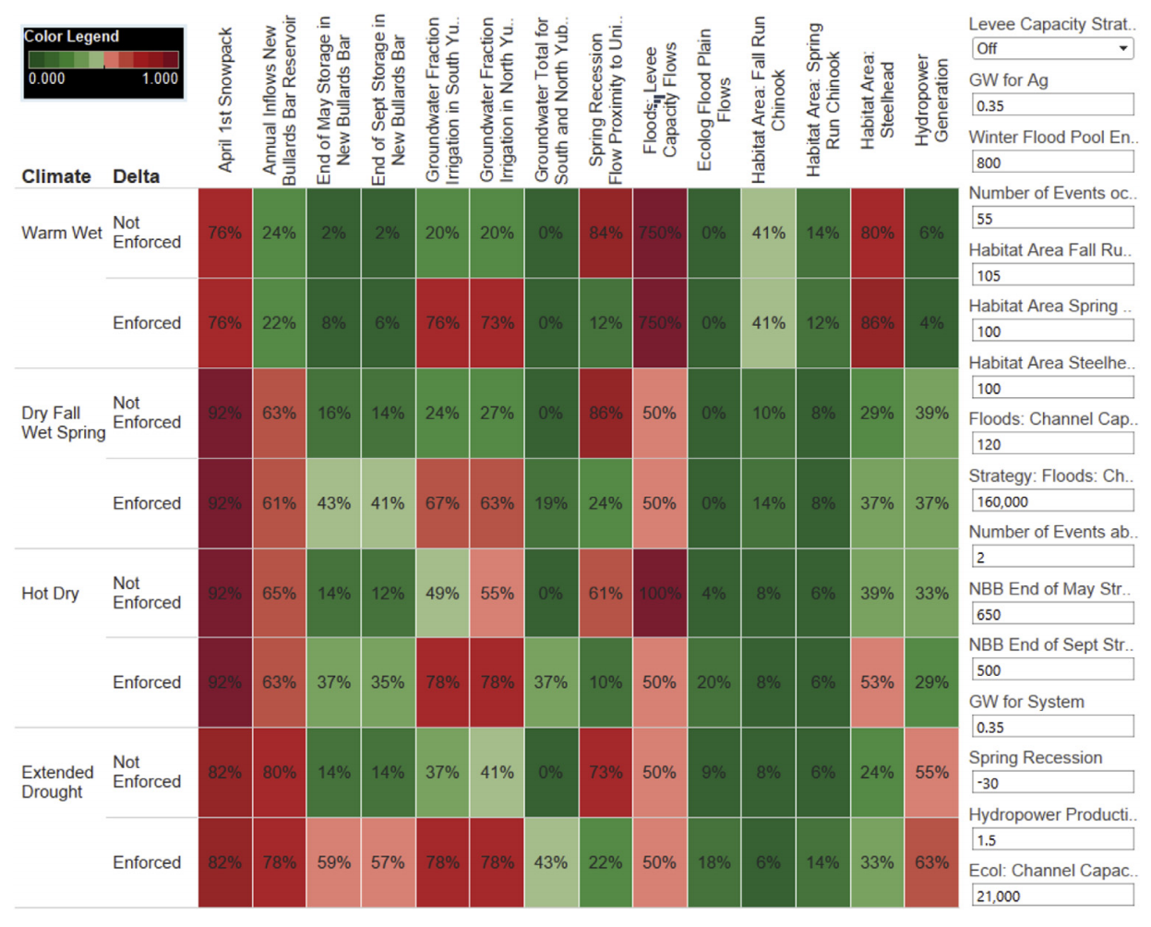
Develop an integrated plan
Multi-criteria analysis
Cross-impact analysis
Integrated modeling
Forni et al., 2016

Slide 14
Develop an integrated plan
Multi-criteria analysis
Cross-impact analysis
Integrated modeling
Kemp-Benedict and Agyemang-Bonsu, 2008

Slide 15
Develop an integrated plan
Multi-criteria analysis
Cross-impact analysis
Integrated modeling
http://www.millennium-institute.org/integrated_planning/tools/SDG/

Slide 16
Stations in the room
UNOG’s Perception Change Project
Sign-up for discussion
Please choose a breakout group:
Environment and the humanitarian sector
Environment and poverty
Urban pollution, health and sustainable development
EMG Nexus Dialogue Visualization tool
Method clinic
Open discussion about choosing methods

